Slide 1
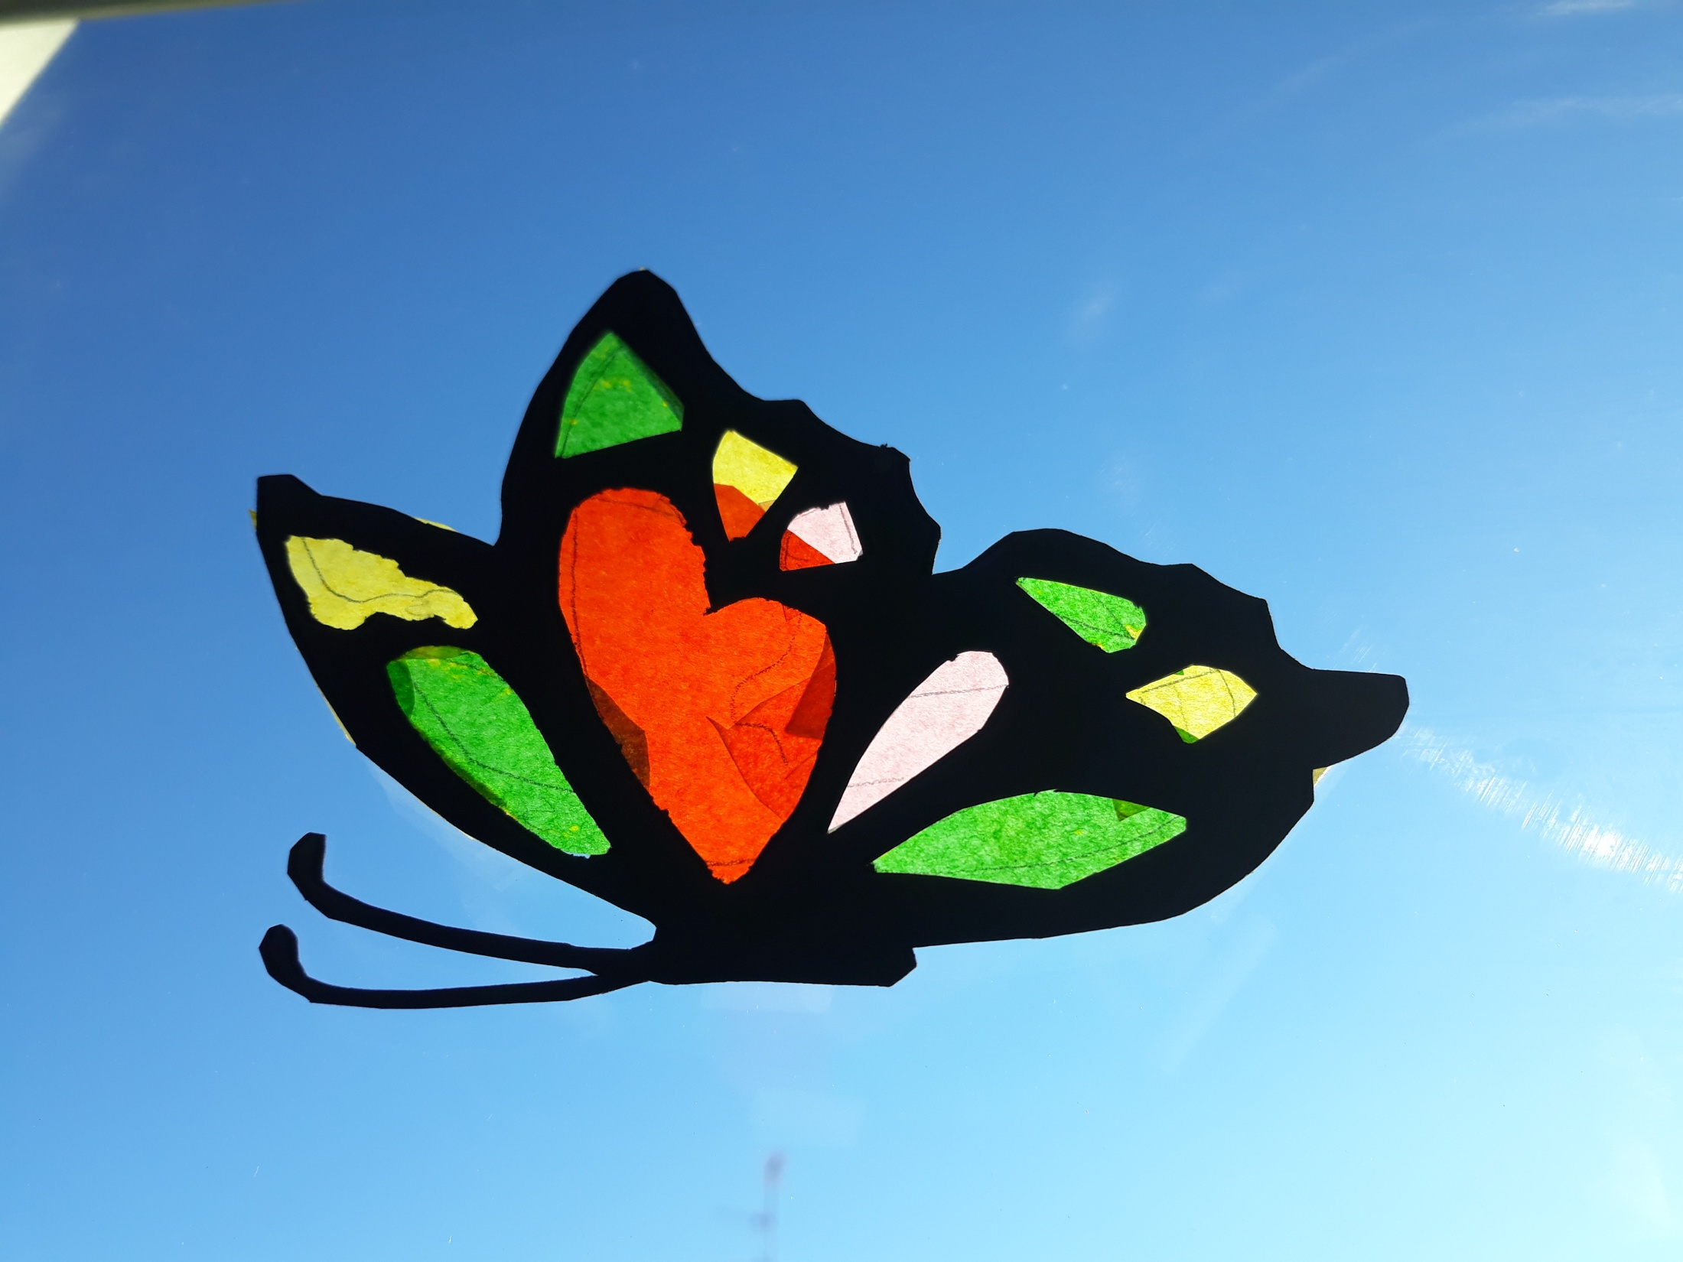
THE MOST SIGNIFICATIVE CHANGE

Slide 2
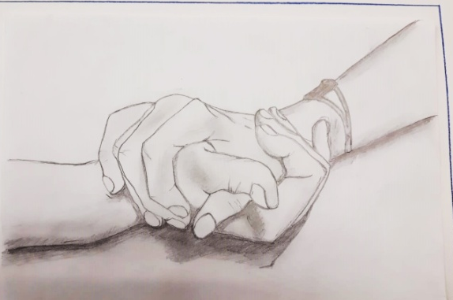
GABRIELE
“THE MOST SIGNIFICANT CHANGE”
Bulling is not a good thing at all.
And we must stop it.
Since I was a child they have mocked me,and in part they keep doing it still now,but I learnt to ignore these silly behaviours; for me it has been easy but for others it is almost impossible. This year at the middle school I learnt many other things about bullying. Thanks to a meeting with a criminologist I understood better the peronalities of the bully and his victim :thanks to the esperience of my classmates I learnt that everybody can become the victim of a bully but also that a bully can apologise with the victim.
I learnt that adults will always support you, and if you don’t manage to talk about it with your parents or teachears it is important to find a friend to confide his own unease. You must never turn in yourself but express and talk with somebody who can help you.
I’m a friend of bullies and victims.
Once I asked a bully why he insulted and beated other guys. He told me that in his old school some kids behaved as bullies so he agreed with a friend to emulate their behaviour.
My class takes part in a project:”I am not a target”.Other nations cooperate in this project. Some teachers of ours have taken part to some training courses and visited partners school in order to observe their work.
The symbol is a butterfly representing freedom. We started our route watching the film “pay it forward “ . everyone among us Had to do a favor to 3 different people and everybody it’s turn had to pay it forward.
We also tried to pay it forward involving other classes. I worked at the project with interest Because I know what being bully means, I found out and my Friends know, that if they’re in trouble, I’ll be ready to help them.

Slide 3
Reflection about bullying project by Emily Ciraci, 2B
Bullyingis a serious phenomenon which takes place into and outside schools. It is a continuous persecution towards a person who is often stronger than the bully but can’t show it. The bully is a fragile person that for several reasons must find excuse to show his strenght and he does it roughing the others up. Cyberbully in giseven worse than bullying, it is the internet bullying, the persecution quickly goes viral world wide. We students of 2B are taking part in the project “ I am not a target “ : first of all wew atched the film “Pay it forward”, that tells the story of a guy who has the duty of finding an idea and chooses the forward: doing 3 favours to 3 people who, in their turn, must do the same with other 3 people and so on. Weal so realised bill boards about the project and partecipated to a meeting with the criminilogist Franco Posa who toldus his personal experiences.In the classroom we discussed and assumed how this worls and our life could be come if we used technology positively that is not able part of our life. All these works and discussions helped me to behave in an adeguate way in case I assisted to a bullying episode or I was in danger. First of all one must inform his parents or teachers or the competent authotities.
In my opinion we some times tend to consider some casual behaviors or simple jokesamong friends as bullying episodes and this entails some wronge valuations (coming) from people who don’t know the subject adeguately. A thing that made me think over a lotis to discover that the bully is often a person looking strong but is actually weak and a risk of bullying. At home we talk about it ans I also involved my family. My mother i salso reading a book facingth is matter, whose title is “Girls revolution” (by Alberto Pellai).

Slide 4
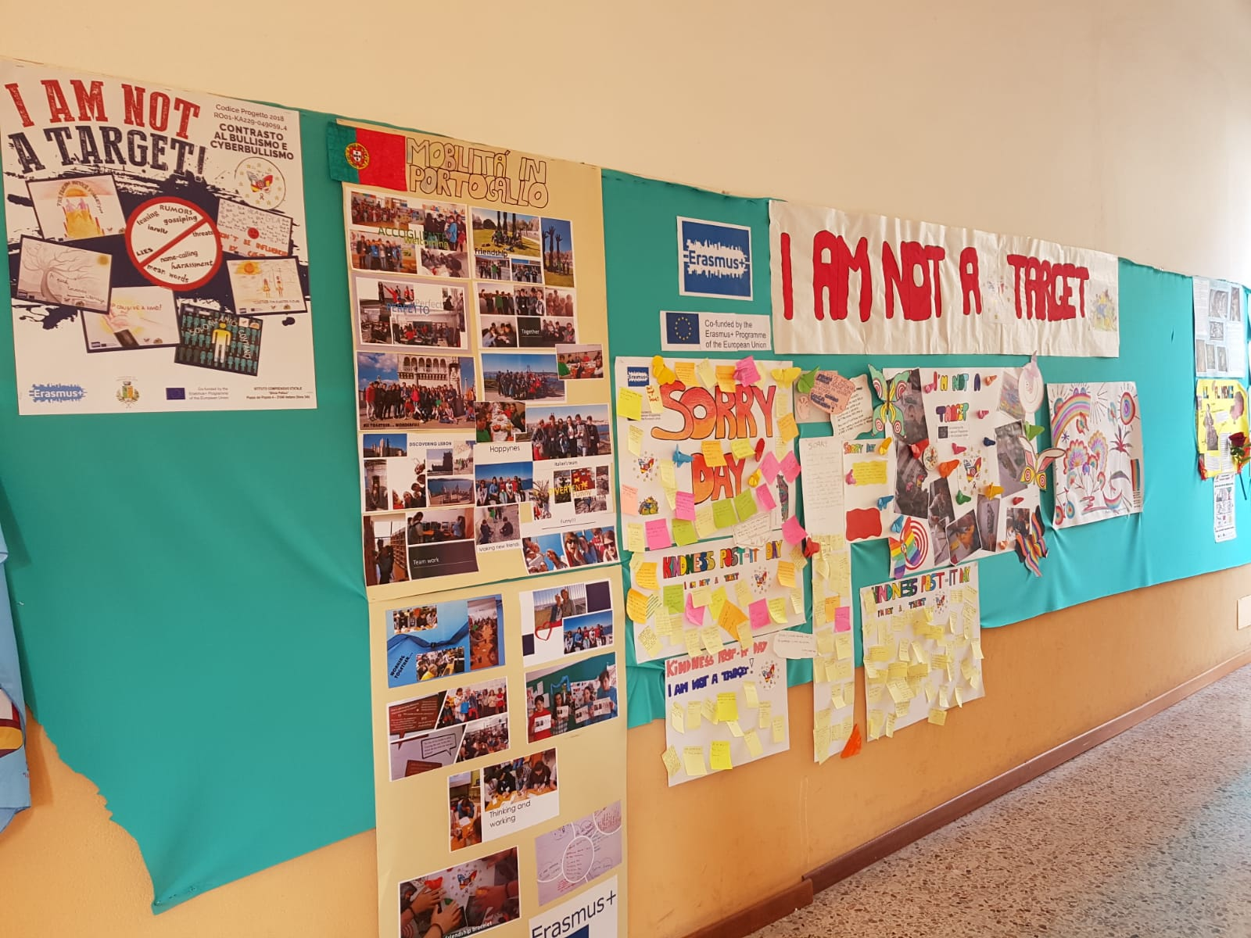
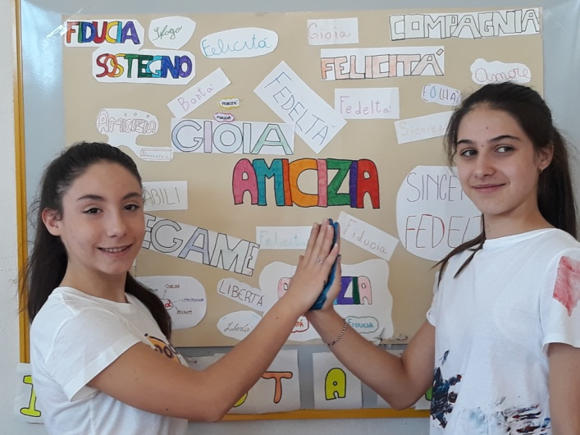
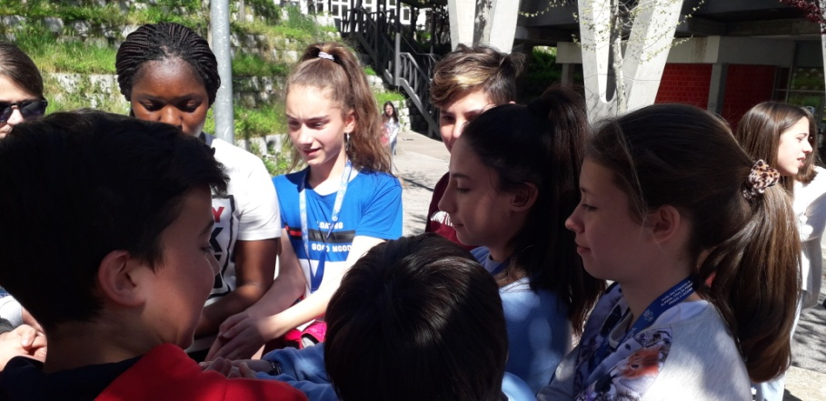

Slide 5
I AM NOT A TARGET (THE MOST SIGNIFICANT CHANGE) –
by GIRIMONTE ASIA 2B
This year our school took part in "I am not a target" project which helped us to understand the meaning of our actions, to take a position against injustice, to report if we are in danger and to distinguish between a bully and cyberbully.
The bully accomplishes physical acts of violence, as an aggressive attitute towards a weaker person with the complicity of other mates who, recognizing him as a leader, emulate his attitudes.
The cyberbully is a bully taking advantages of tecnology, of electronics devices in order to intimidate, threaten, defame and mock and harm a mate unable to defend himself because of his insicurity and weakness. In our classroom there has always been, in general, a good atmosphere even if this year we had an act of bullying.
Luckily thanks to this project everything has positively changed all of us understood his own mistakes and learnt to manage the situations, differently, without exceeding the limits.
For me the most positive significant change of this year is the attention in apologizing or for example respecting the other more, and mostly i understood that, before acting in a wrong way, offending, mistreating, mocking the others, you must reflect and think: "how would i feel if it happened to me?"
This is the crucial question everybody should think of before acting incorrectly.
Personaly i pay more attention to the words i say, because a message is easily misunderstood and used to pierce the soul, moreover i try to avoid gossip, i am also careful in using social media and i posting and pay attention to virtual frienship that you can create.
I use privace filters and share everything with my parents.
I liked this project very much and i hope it goes on, because it was really instructive

Slide 6
“The most significant change”
by Ilaria Sada
Unluckily the word “bullying” has entered to be part of the daily language and often, watching the tv news, I hear of unpleasant facts linked to this bad phenomenon which is more and more increasing.
What does “bullying” mean? Bullying consists in hurting somebody intentionally and repeatedly, both physically and verbally. The victim is a weaker person, unable to defend himself/herself. For example a quiet, shy, introvert, kind and polite guy who tends to sit back represents an easy prey for the bully.
But who is the bully? The bully is defined as a bossy, strong and bold person who mocks, humiliates and beats a younger or weaker person.
Surely we notice an aggressive attitude aiming at hurting, classmates or playmates who look temperamentally and physically helpless with words or gestures .
Female bullying also exists. Girls who feels bigger and uninhibited, thanks to physical appearance too, show some bullying in form of gossips and lies towards some contemporaries in order to mock and exclude them from the group. I often wonder why this form of violence, which leads to hurt someone, exists. I can’t understand why people can’t feel good together (for example at school) and share all the beauties our age can offer us.
During this school year, my school has organized a lot of activities inherent cyberbullying and bullying. In class we have read some excerpts, which started discussions and reflections, to understand these awful words belonging to our daily routine better.
I have had the luck to participate in the project “Erasmus + - I am not a target” which allowed me and other 3 students from the second classes to enjoy a stay in Portugal and it also involved students from different nations (Romania, Portugal, Spain, Cyprus and Greece). We started analysing all the emotions of the bully and the victim, and finally the danger of social networks.
We have learnt that, if we work as a group, we can defeat bullying and cyberbullying; we have to help whoever doesn’t find the courage to ask for help and we mustn’t be insensitive or ignore facts that take place under our eyes.
I’m very sensitive about this topic because I’ve been a victim of bullying. My family has been my strength because it has been able to listen to me and especially to give me protection. I have had the courage to speak to save myself and other possible victims.
Last year in my classroom there were cyberbullying episodes towards a classmate of mine, and, without hesitating, I told my mother what was happening and she informed the teachers at once. I didn’t feel as a spy but as a great helper.
During this school year a mate of mine has kept on disseminating fake news about me and sending those famous “hurting texts” through her mobile phone. How did I react? I blocked her number: this represents my most meaningful change! Are you targeting me? Well, I will ignore you until you change your childish behaviour.
I surely feel stronger and more secure but in the meantime I’m really disappointed because the person I helped in the past, instead of being my friend, is just the one I had to block. I don’t mind. I chose to do what makes me feel good.

Slide 7
